Slide 1
Lab (1) Introduction to Clinical chemistry For 2nd year student
Ibn Sina University of Medical
and Pharmaceutical Sciences
College of Dentistry
Clinical Biochemistry Lab
Done by: Ass. Lec. Farah Saadoon Jaafer
M.SC. in Inorganic Chemistry

Slide 2
Outline
Clinical chemistry definition.
Biological Specimens.
Blood Specimens.
Preparation of Blood Sample.
Blood collection tubes.
Sampling errors.
Biological factors affecting the interpretation of results.
Specimen rejection criteria.

Slide 3
The Clinical Biochemistry
Clinical chemistry is a quantitative science, that concerned with measurement of amounts of important bio-chemical substances (analytes) present in body fluids for diagnostic and therapeutic purposes.
The tests in a clinical chemistry laboratory measure concentrations of biologically important ions (salts and minerals), small organic molecules and large macromolecules (primarily proteins). So, the tests may be classified depended on the type of analyte as in the following table or we can classified as :
Lipid profile
Diabetic profile
Kidney profile
Liver profile
Bone profile
Electrolyte profile

Slide 4
Common analytes in the clinical chemistry laboratory
Ions, Salts and Minerals |  | Potassium,Sodium,Calcium,Chloride,Magnesium,Phosphorus, Carbon Dioxide (CO2),Lead,Iron.
Small Organic Molecules | Metabolites | Glucose,Cholesterol,Urea,Lactic Acid Bilirubin,Creatinine, Triglycerides, Ammonia,Cystatin C.
 | Therapeutic Drugs | Vancomycin,Theophylline,Digoxin,Phenytoin,Valproic acid.
 | Toxicology | Alcohol (ethanol),Salicylate (aspirin),Acetaminophen
 | Drugs of Abuse (DOA) | Cocaine, Barbiturates, Amphetamines ,Opiates,Cannabinoids
Large Macromolecules | Transport Proteins | Albumin, Transferrin, Haptoglobin, Ferritin
 | Enzymes | Lipase, Amylase, Alanine, Aminotransferase (ALT), Aspartate Aminotransferase (AST), Alkaline Phosphatase (AlkP), Lactate Dehydrogenase (LD), Creatine Kinase (CK)
 | Defense Proteins | Immunoglobulins, Complement C3, Complement C4
 | Lipoproteins | High Density Lipoprotein (HDL), Low Density Lipoprotein (LDL), Lipoprotein (a)
 | Proteins | Hemoglobin A1c (Hb A1c), C-Reactive Protein (CRP)

Slide 5
Biological Specimens
Blood : whole blood ,Serum or plasma.
Urine
Saliva
Cerebrospinal fluid (CSF)
Amniotic fluid
Synovial fluid (fluid that is found in joint cavities)
Pleural fluid (from the sac surrounding the lungs)
Pericardial fluid (from the sac surrounding the heart)
Peritoneal fluid (also called ascitic fluid; from the abdomen)

Slide 6
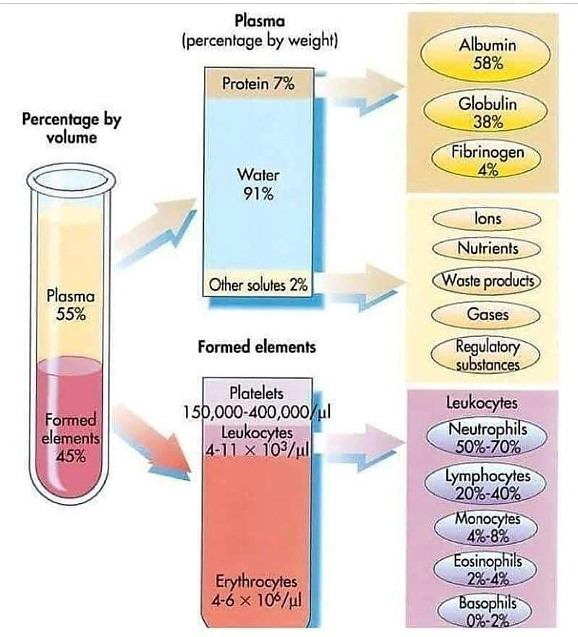
Blood Specimens
Blood is a tissue that circulates in a closed system of blood vessels. It consists of solid elements - red and white blood cells and the platelets- suspended in a liquid medium, the plasma.

Slide 7
Blood Specimens
Blood has a number of functions that are central to survival, including:
Supplying oxygen to cells and tissues
Providing essential nutrients to cells, such as amino acids, fatty acids, and glucose
Removing waste materials, such as carbon dioxide, urea, and lactic acid
Protecting the body from infection and foreign bodies through the white blood cells
Transporting hormones from one part of the body to another, transmitting messages, and completing important processes
Regulating acidity (ph) levels and body temperature
Engorging parts of the body when needed.
Another important function of the blood is its protective action against disease. White blood cells defend the body against infections, foreign materials, and abnormal cells.

Slide 8
Preparation of Blood Sample
One of three different specimens may be used: whole blood, serum, or plasma. Serum and plasma are prepared from whole blood by centrifugation
- Whole blood:
Whole-blood specimen must be analyzed within limited time (why?)
Over time, cells will lyse in whole-blood which will change the conc. of some analytes as potassium, phosphate and lactate dehydrogenase.
Some cellular metabolic processes will continuo which will alter analytes conc. like glucose and lactate.

Slide 9
- Serum or plasma:
Differences between serum and plasma:
Serum has the same contents as plasma (electrolytes, enzymes proteins, hormones) except it doesn't contain clotting factors (as fibrin).
Serum is mainly use in chemistry lab & serology.
Some clinical chemistry tests are best performed using plasma, others are best performed using serum, and still others can be performed using either plasma or serum.

Slide 10
Blood collection tubes:
They are specific tubes evacuated from air called vacutainer tubes. There are two major types of blood collection tubes:
Serum separating tubes (SST): contain no anticoagulants.
Plasma separating tubes (PST): contain anticoagulant or preservative [Potassium oxalate, potassium flouride, sodium citrate, trisodium EDTA , heparin]
- Blood anticoagulants:
Coagulation occurs in two major steps:

Slide 11
Blood anticoagulants
They are substances which prevent blood coagulation. They inhibit coagulation process by eliminating Ca²⁺ ions which are important in coagulation or by binding with thrombin and prevent conversion of fibrinogen to fibrin where EDTA, citrate and oxalate ; inhibits coagulation by binding with Ca²⁺ and prevent the activation of prothrombin to thrombin, while Heparin: inhibits coagulation by binding with thrombin which is important in activation of fibrinogen to fibrin.
Choose the correct anticoagulant in blood collection is very important. It depends on the test to be performed; anticoagulant shouldn't interfere with the substance to be analyzed (measured).
False positive or false negative results may be produced if blood collected in tube contains wrong anticoagulant.

Slide 12
Blood anticoagulants
Here are some examples:
Tubes contain sodium and potassium anticoagulants are not used in measuring concentration of electrolytes; this will produce false positive result (Li, ammonia or heparin is used in electrolytes).
Tubes contain Na⁺-oxalate anticoagulant are not used for measuring Ca²⁺ level; because oxalate will react with Ca²⁺ and precipitated as Ca²⁺-oxalate.
EDTA and citrate are not suitable for enzymatic assays, because it binds with Ca²⁺ ion that is a cofactor for enzymes like alkaline phosphatase.
Fluoridated oxalate specimen is often recommended for glucose.

Slide 13
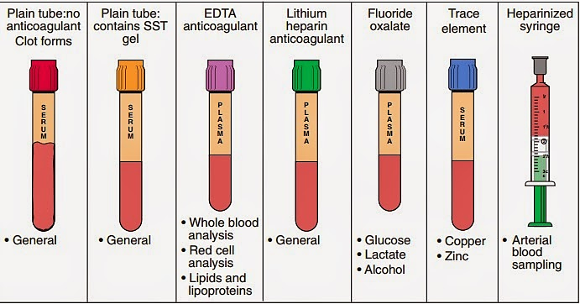
Blood anticoagulants
Tubes used to collect blood have color-coded caps that signal what, if any, additives are present in the tube. Additives may be anticoagulants to allow preparation of plasma or may be substances included to protect analytes from chemical or metabolic breakdown.

Slide 14
Sampling errors
There are a number of potential errors which may contribute to the success or failure of the laboratory to provide the correct answers to the clinician's question. Some of these problems arise when a clinician first obtains specimens from the patient.
Blood sampling technique.
Prolonged stasis during venepuncture.
Insufficient specimen.
Errors in timing.
Incorrect specimen container.
Inappropriate sampling site.
Incorrect specimen storage.

Slide 15
Biological factors affecting the interpretation of results
The discrimination between normal and abnormal results is affected by various physiological factors which must be considered when interpreting any given result. These include:
Sex of the patient.
Age of the patient.
Effect of diet.
Time when sample was taken.
Stress and anxiety.
Posture of the patient.
Effects of exercise.
Medical history.
Pregnancy.
Menstrual cycle.
Drug history.

Slide 16
Specimen rejection criteria:
Specimen improperly labeled or unlabeled.
Specimen improperly collected or preserved.
Specimen submitted without properly completed request form.
Hemolyzed sample.
** Haemolysis may occur due to:
Dispense of blood directly from syringe through needle, the applied pressure may cause rupture of RBCs.
Refrigerate non-separated blood sample (too cold, too hot will also effects).
Mechanically due to blood sample shaking.

Slide 17
** Changes in the serum color indicate one of the following:
Hemolyzed: serum appears pink to red due to rupture of RBCs.
Icteric: serum appears yellow due to high bilirubin (Jaundice).
Lipemic: serum appears milky or turbid due to high lipid.

